Slide 1
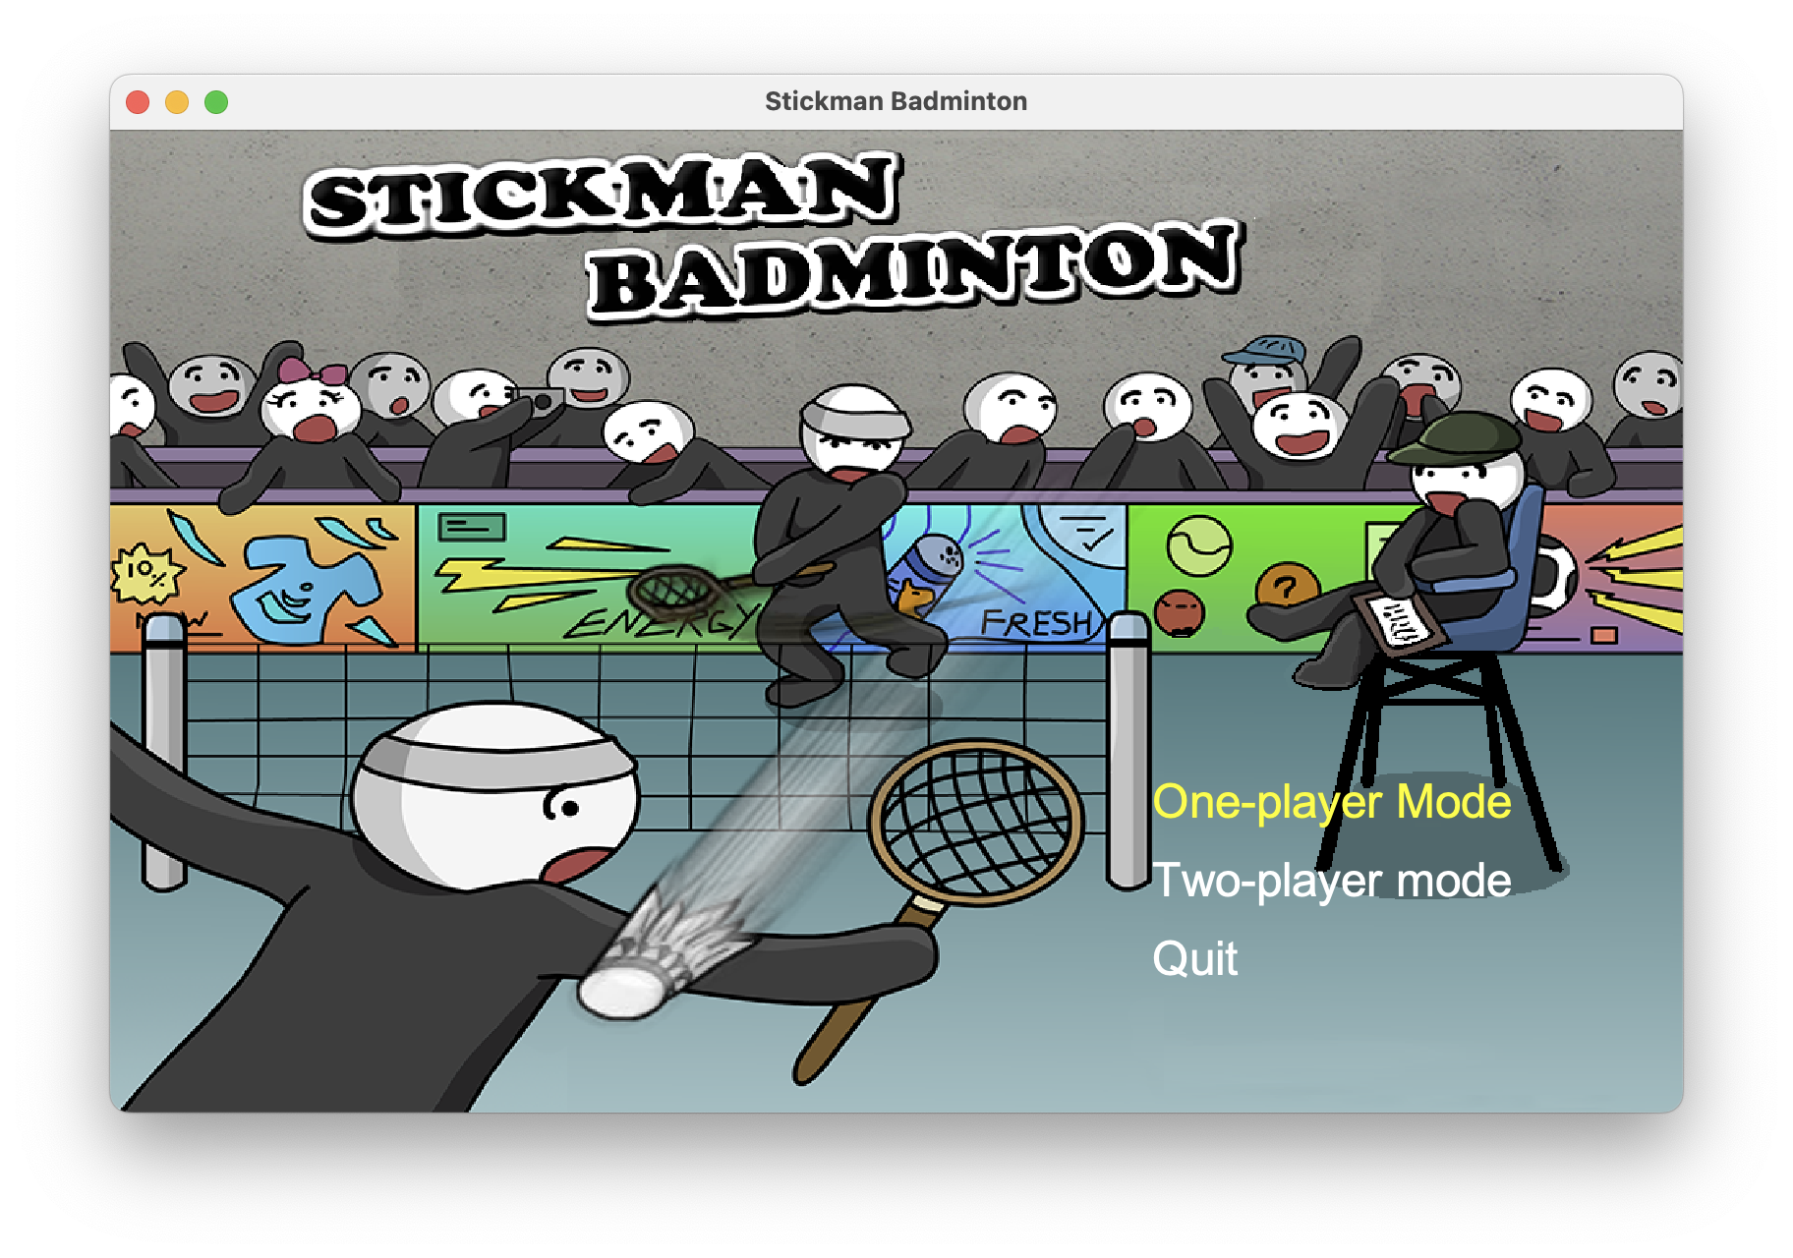
Stickman Badminton
Group 21

Slide 2
TABLE OF CONTENTS
01
03
02
04
Introduction
Game Feature
Introduction and background of the game
Introduction of the game feature
Gameplay Introduction
About us
Game rules and the operations
Team member and contribution

Slide 3
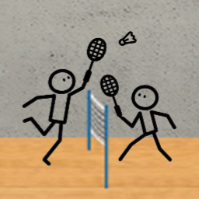
01
Introduction
Introduction and background of the game

Slide 4

Game Background
Stickman Badminton is a faithful remake of the hit mobile title Stickman Badminton by German studio Djinnworks. The Stickman has a simple and cute image, is easy to operate, and is suitable for players of all ages.

Slide 5
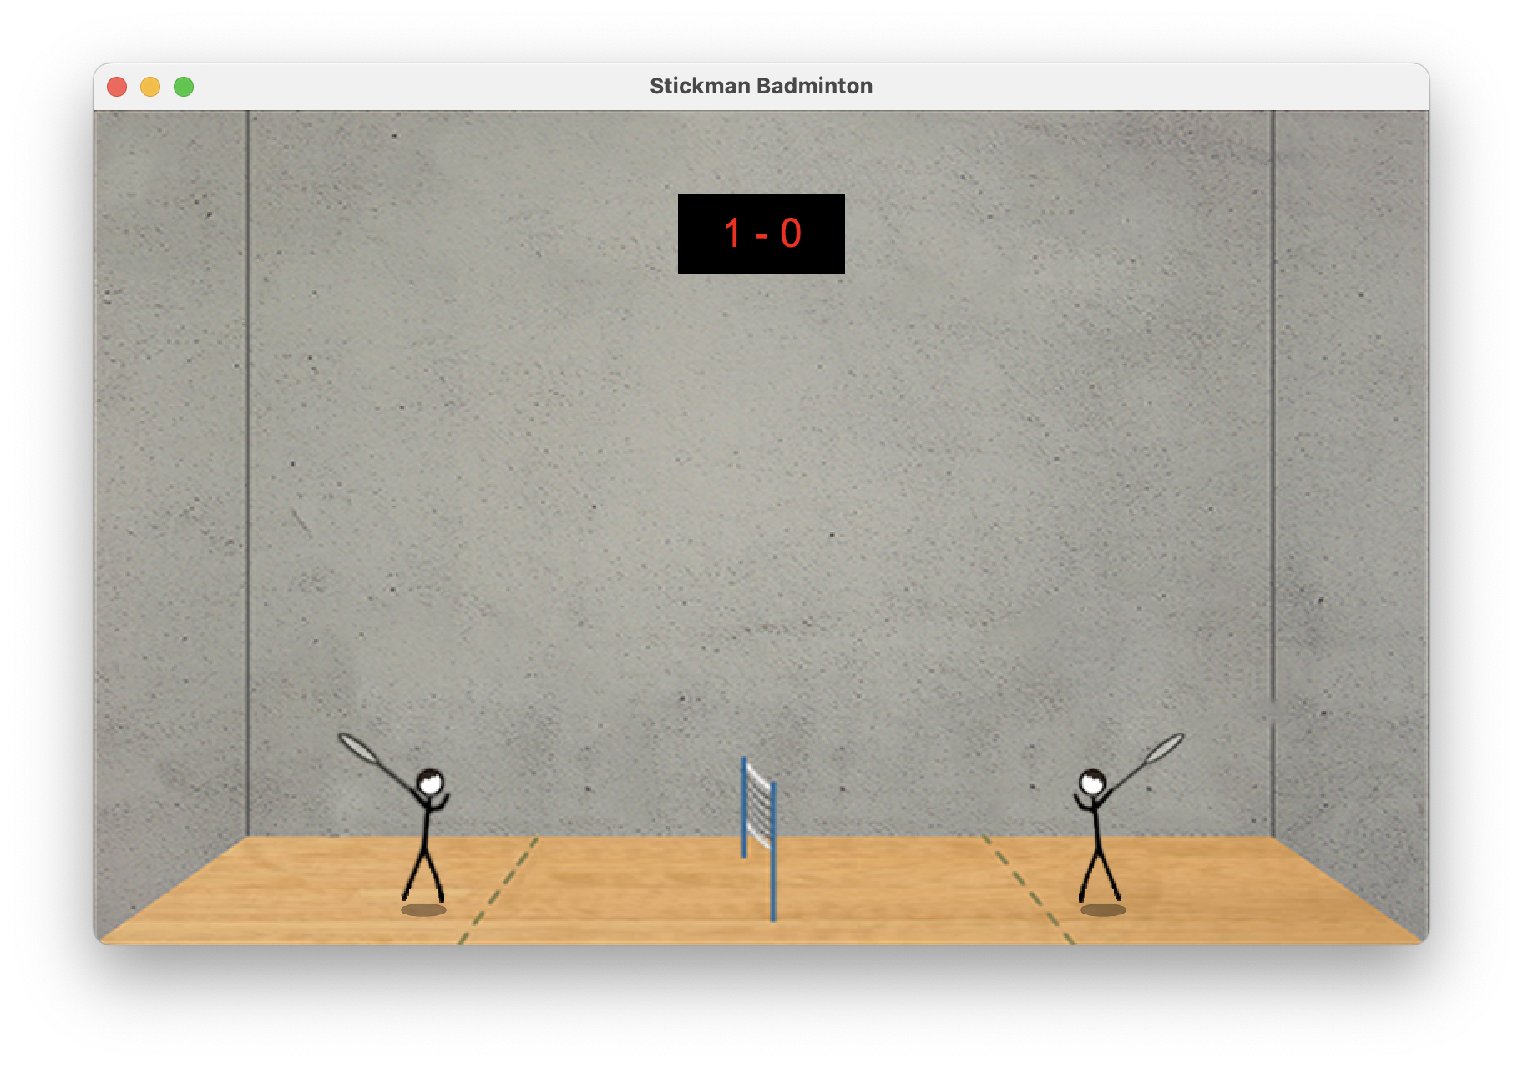
In-Game Overview

Slide 6
Gameplay Introduction
02
Game rules and the operations

Slide 7

Game Rules
Win a rally by landing the shuttlecock so your opponent fails to return it over the net.
The player who wins a rally serves the next
point.
The first player to reach 21 points wins the
match.

Slide 8
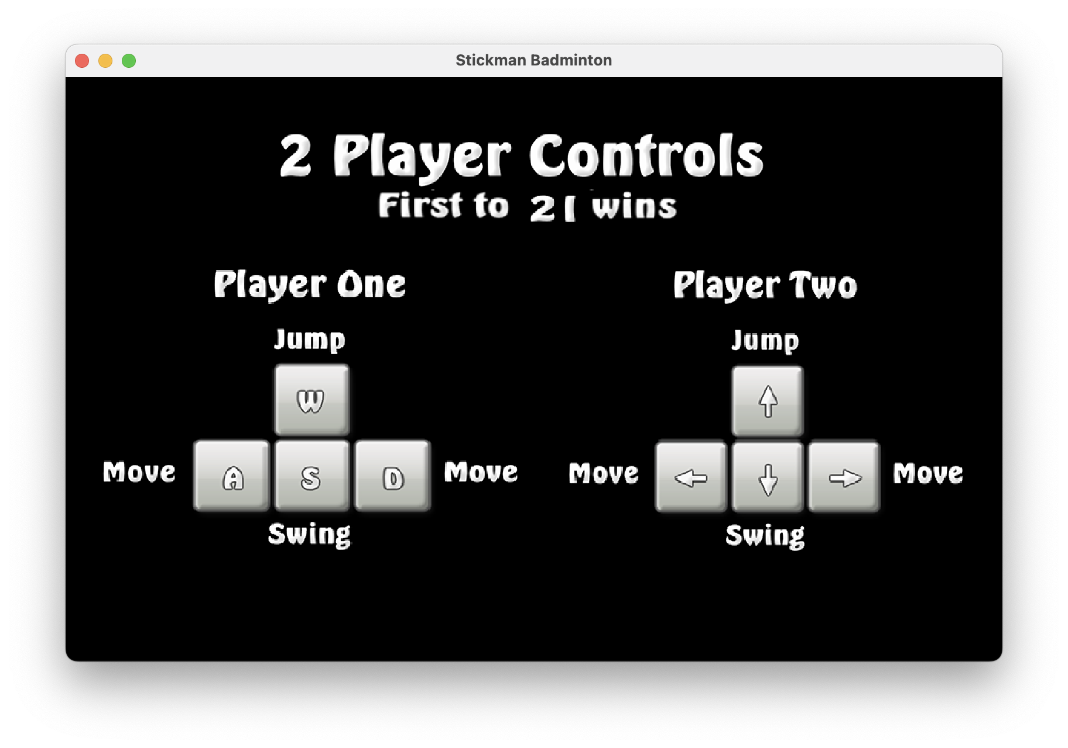
Operations

Slide 9

03
Game Feature
Introduction of the game feature

Slide 10
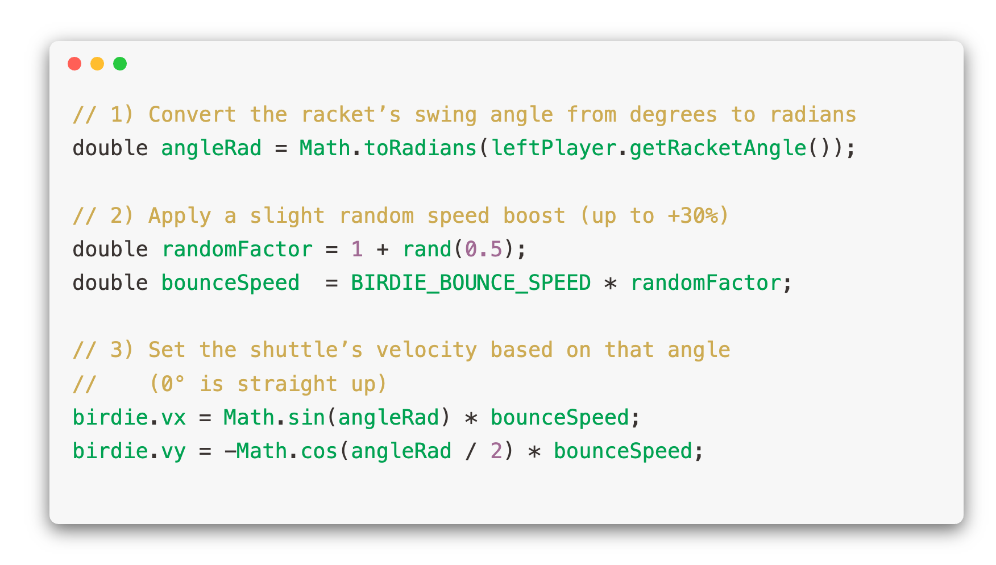
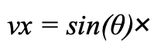
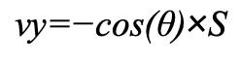
Realistic Shuttlecock Bounce
Our physics model computes each hit’s launch vector by combining the racket’s swing angle and a speed factor:
$$\text{vx}\text{​} \text{=} \text{sin}\text{(}\text{θ}\text{)}\text{×}$$
$$\text{vy}\text{​=−}\text{cos}\text{(}\text{θ}\text{)}\text{×}\text{S}$$
where S includes a small random multiplier (up to +30%) for natural variation. The shuttle also loses 30% speed on wall/ground contacts for a believable flight arc.

Slide 11
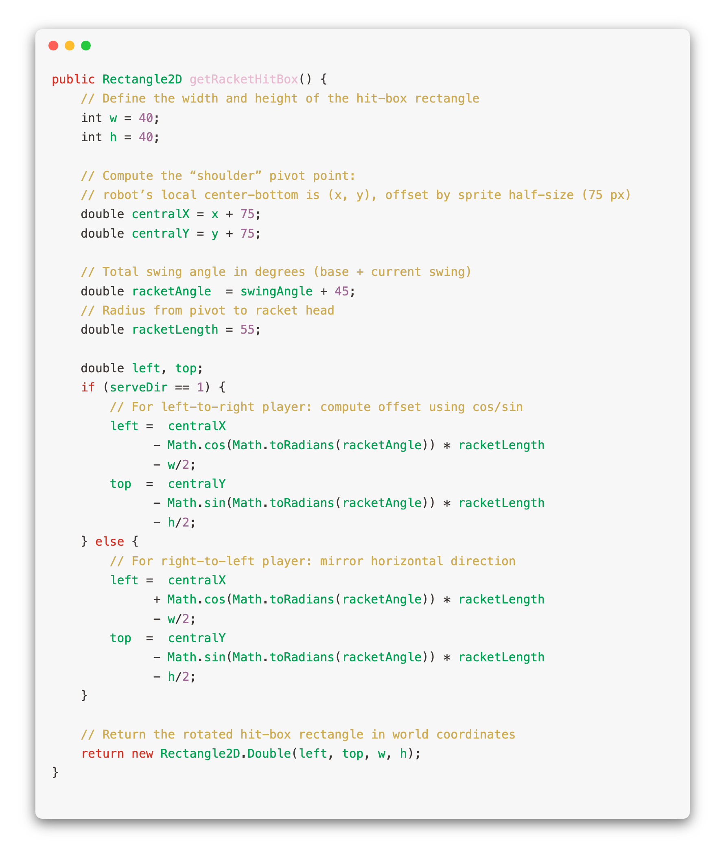
Dynamic Racket Hit-Box Tracking
The game dynamically computes a rectangular hit-box that follows the racket’s rotation and position each frame. This ensures collisions only occur when the swing animation actually overlaps the shuttlecock—resulting in precise, visually consistent hits.

Slide 12
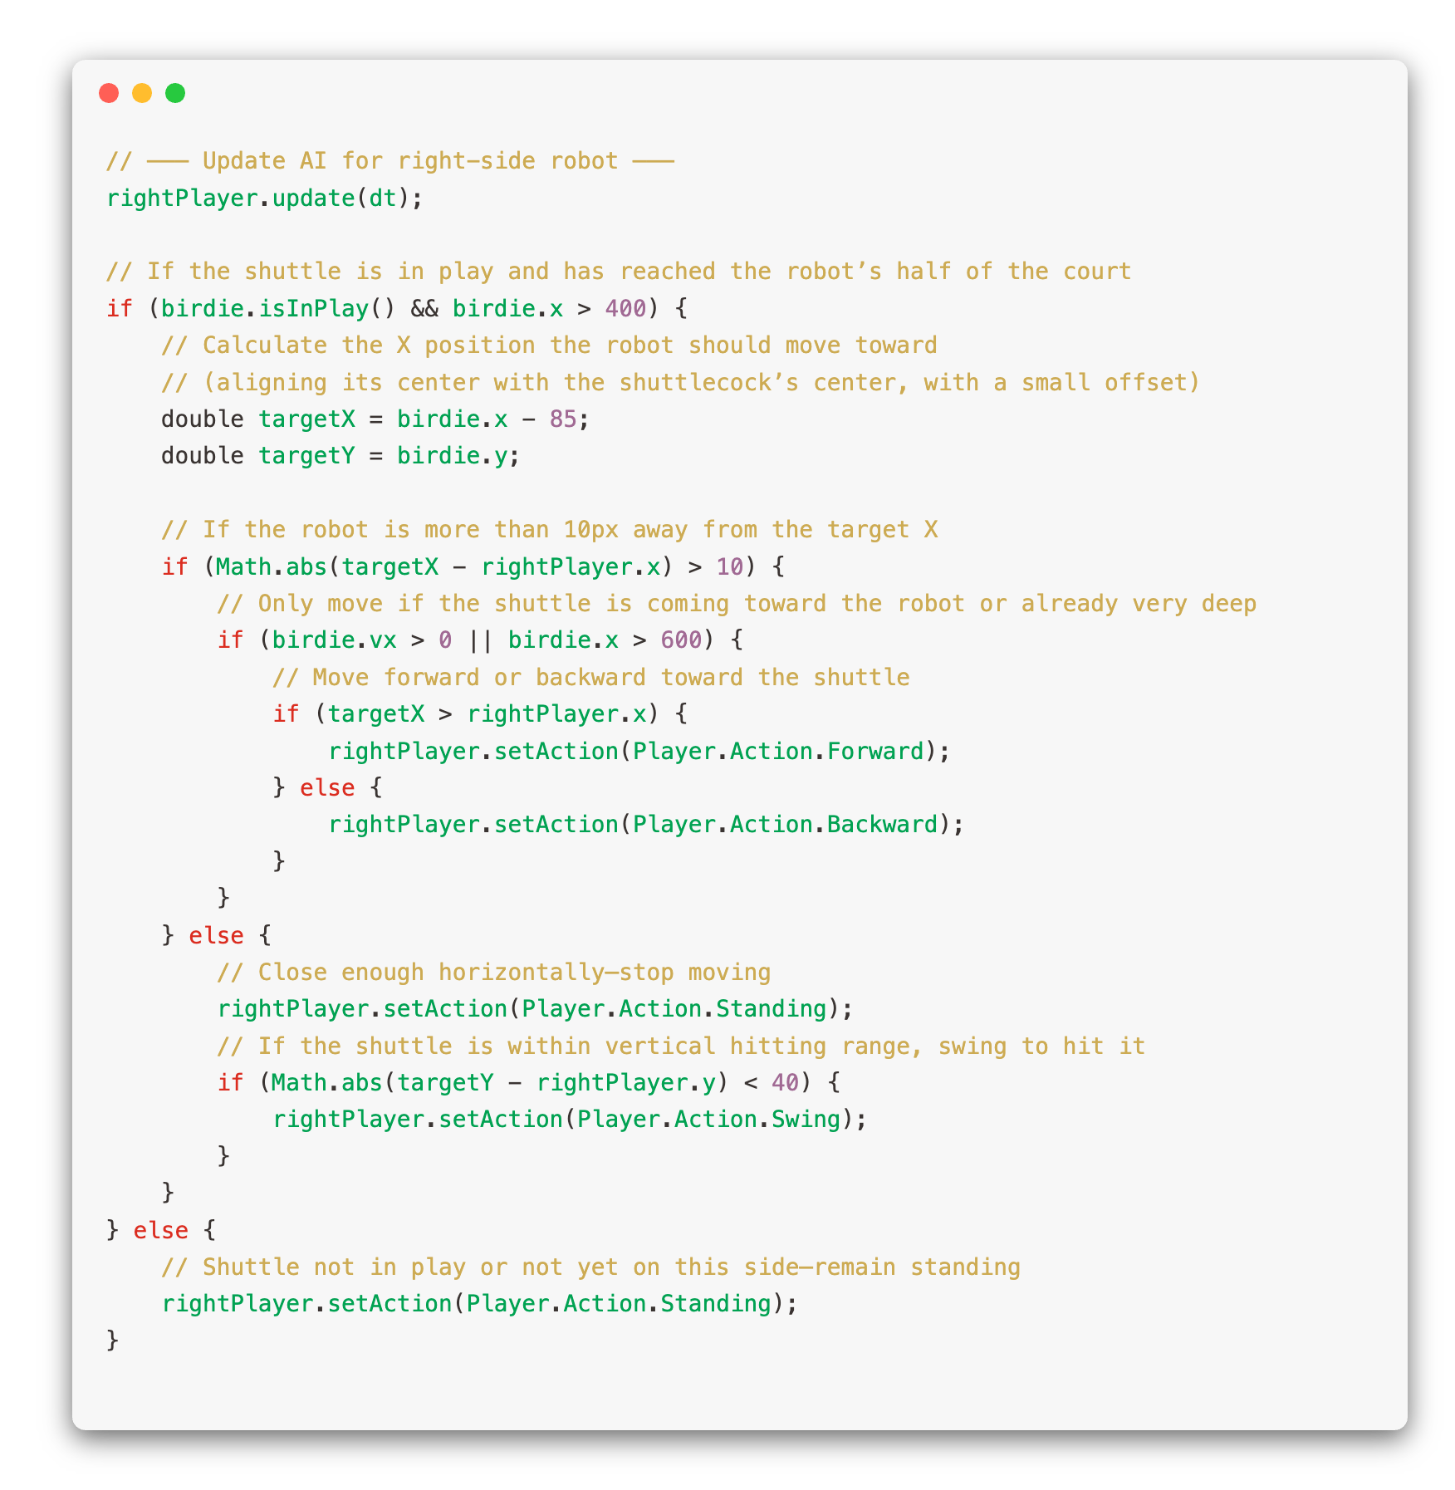
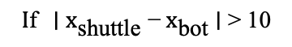
AI Opponent Tracking
The robot continuously measures the shuttle’s x-position and sets its action to Forward/Backward
$$I\text{f} \text{∣} x_{\text{shuttle}}\text{​} \text{−}{ x}_{\text{bot}}\text{​} \text{∣} \text{>} \text{10}$$
When the shuttle enters its racket hit-box, the AI triggers a Swing animation—resulting in surprisingly human-like rallies with minimal computation.

Slide 13
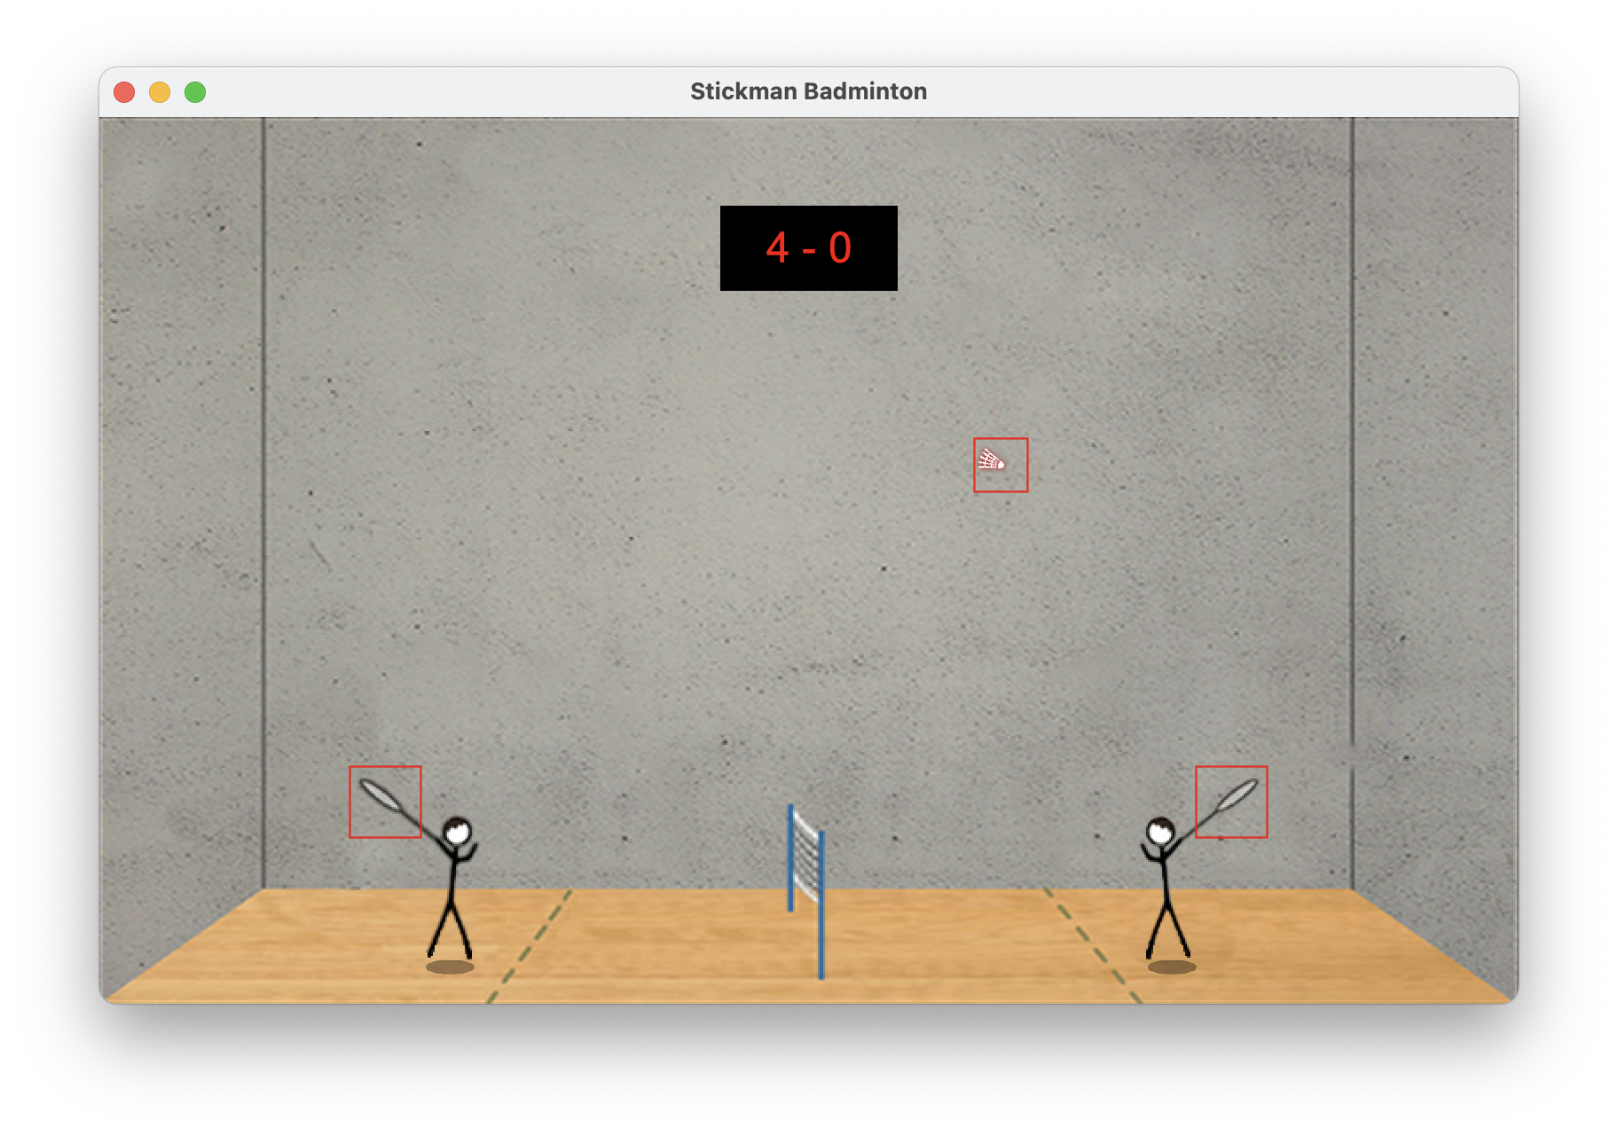
Flexible Game Modes & UX
One-Player : single-player vs AI
Two-Player : local split-keyboard
Quit
Debug Hit-Box Visualization toggle for precise collision tuning

Slide 14
04
About us
Team member and contribution

Slide 15
Team member
Member | Massey ID | Contribute
Jianfeng Pang | 23010084 | Game coding and slides
Yang Li | 23010055 | Image find and edit
Jinhao Guo | 23009971 | Audio and document
Jiale Wang | 23010109 | Slides and documents

Slide 16
Thanks
For listening

